Slide 1
LW-ALDDNet: A Novel Lightweight CNN Model
for Automated Detection of Apple Leaf Diseases
THE 15th INTERNATIONAL IEEE CONFERENCE ON COMPUTING, COMMUNICATION AND NETWORKING TECHNOLOGIES (ICCCNT)
Paper ID: 3712

Slide 2

Authors
Affiliation
Dhaka 1212, Bangladesh
Rizvee Hassan Prito
Md. Bayzid Hassan
Zarin Tasnim Nuzhat
Ratul Saha
Umme Fatema Tuz Sadia
Sabbir Ahmed Sounok
Sajid Faysal Fahim
Aisha Siddika Mim
Shams E Siam
Syed Musayedul Hussain

Slide 3
Introduction
Apple is one of the most consumed fruits in the world.
Apple production can be severely affected by deadly apple tree leaf diseases.
With the help of AI technologies, anyone can now quickly and accurately identify these diseases.
The researchers have employed several ML algorithms to detect and categorize crop diseases from images.

Slide 4
Introduction
A downside of implementing these conventional ML models is that they require manual feature extraction.
Fortunately, the rise of deep learning models has overcome the limitations of traditional ML models.
Convolutional Neural Network (CNN) is a category of deep learning models that can recognize and classify any kind of object from images.
This study is about developing a novel lightweight CNN model for detecting apple tree leaf disease from images.

Slide 5
Related Works
Ref No. | Number of Categories | Model | Model Size | Accuracy
[9] | 4 | Lightweight Three-Conv Layered Deep CNN | 11 MB | 98%
[10] | 5 | Lightweight AlexNet-based CNN | 5.87 MB | 97.36%
[11] | 4 | MobileNetV2 | 14 MB | 91%
[14] | 4 | Lightweight VGG-ICNN | 23.2 MB | 94.24%

Slide 6
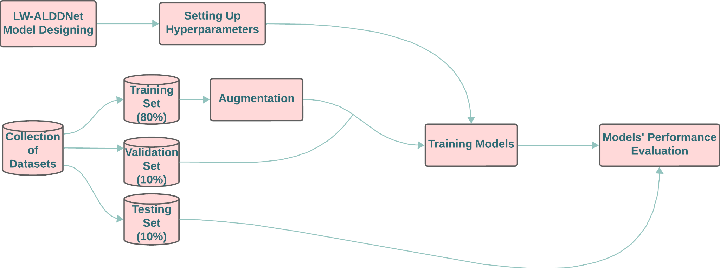
Materials & Method
Fig. 1: Procedure flowchart of this study

Slide 7
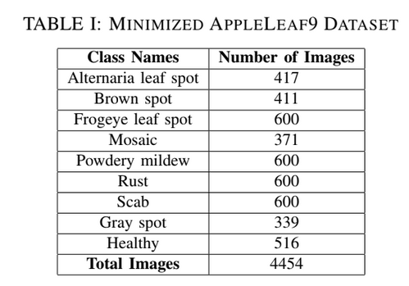
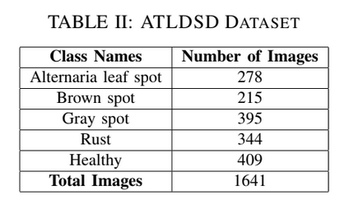
Materials & Method
Selecting Datasets:

Slide 8
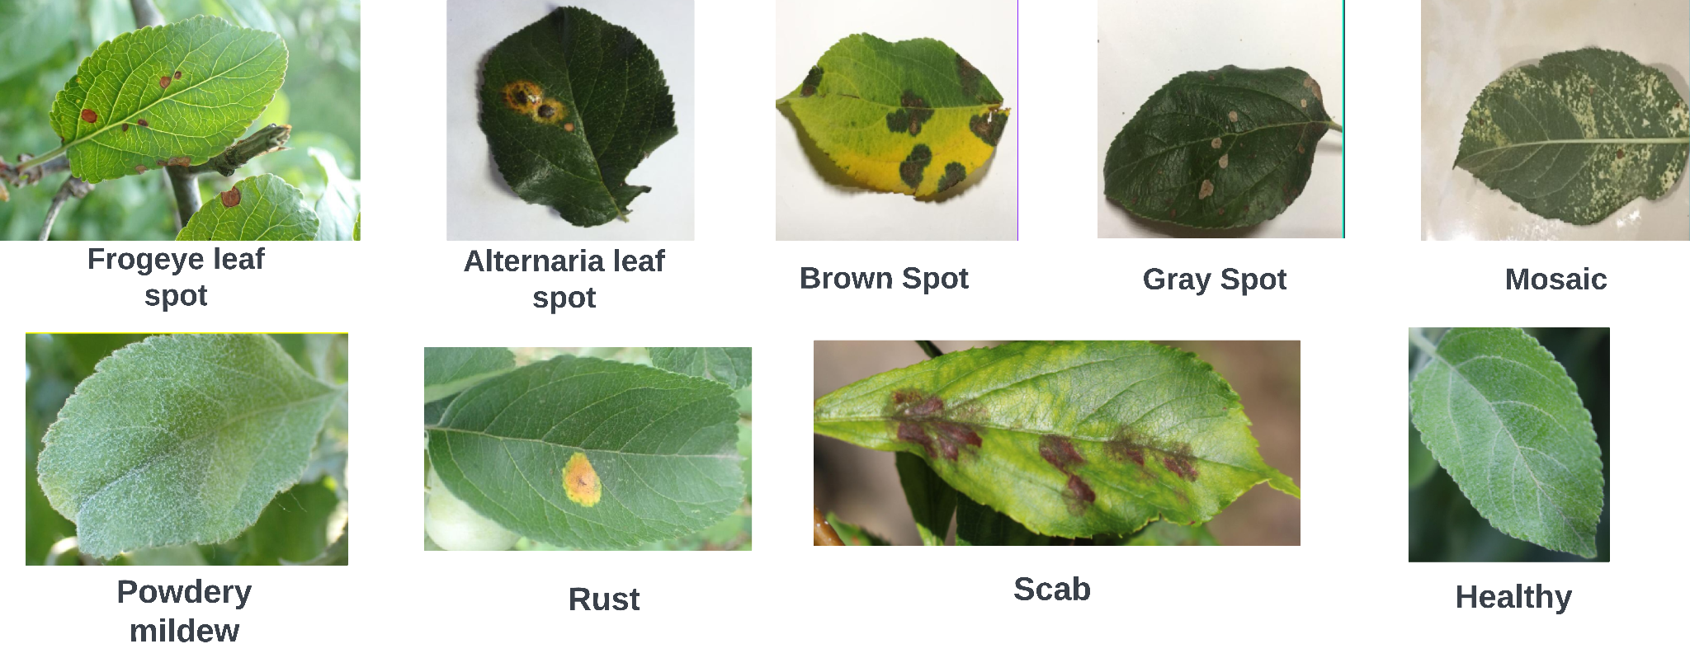
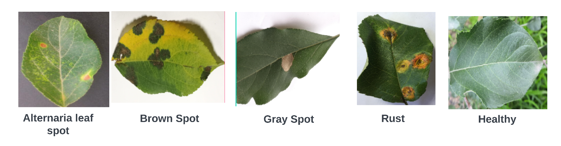
Materials & Method
Sample Images of both datasets:
Fig 2: Sample Images of AppleLeaf9 Dataset
Fig 3: Sample Images of ATLDSD Dataset

Slide 9
Materials & Method
Preprocessing and Augmentation:
Splitting up dataset for 80:10:10 ratios for training, validation, and testing respectively.
Images are resized into 224x224 resolution.
Following augmentation methods are performed on the training part of the datasets:
Augmentation Methods | Values
Flipping | Horizontal, Vertical
90° Rotation | Clockwise, counter-closckwise
15° Rotation | +15° & -15°
Brightness | +10% & -10%

Slide 10
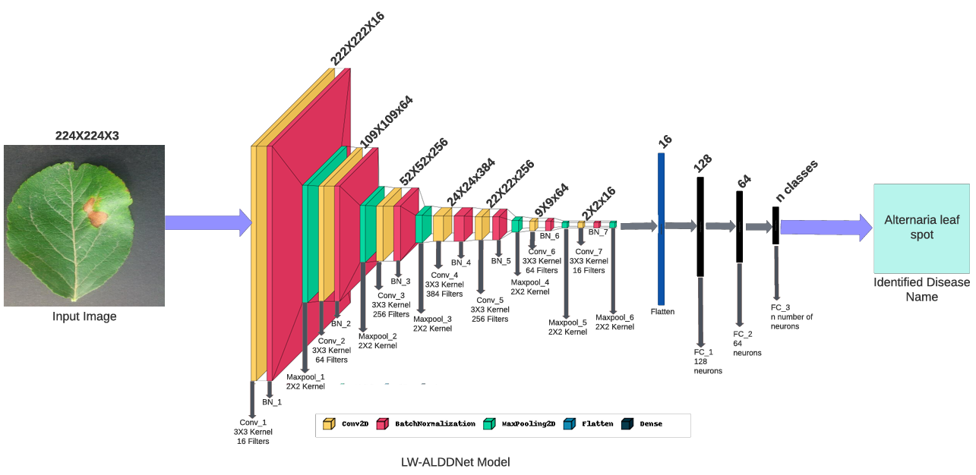
Materials & Method
Architecture of the Proposed Model:
Fig 4: Proposed Model’s Architectu-re and it’s detection process

Slide 11
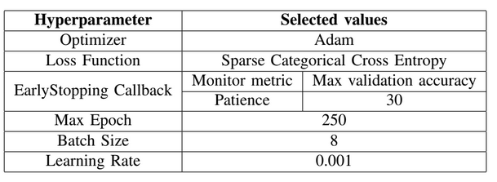
Materials & Method
Setting up hyperparameters and implementation tools:
Following hyperparameters are selected before beginning the training process of the proposed model:
Two online IDEs Google Colab and Kaggle Notebook are used for implementing the model.

Slide 12
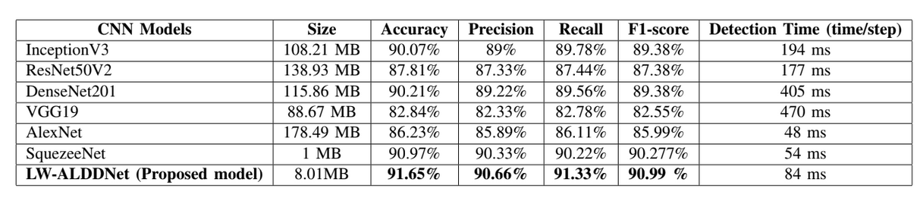
EXPERIMENTAL RESULT & DISCUSSION
Comparisons of the models’ performance on the Reduced AppleLeaf9 dataset:

Slide 13
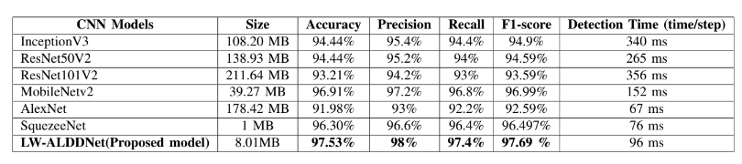
EXPERIMENTAL RESULT & DISCUSSION
Comparisons of the models’ performance on the ATDLSD dataset:

Slide 14
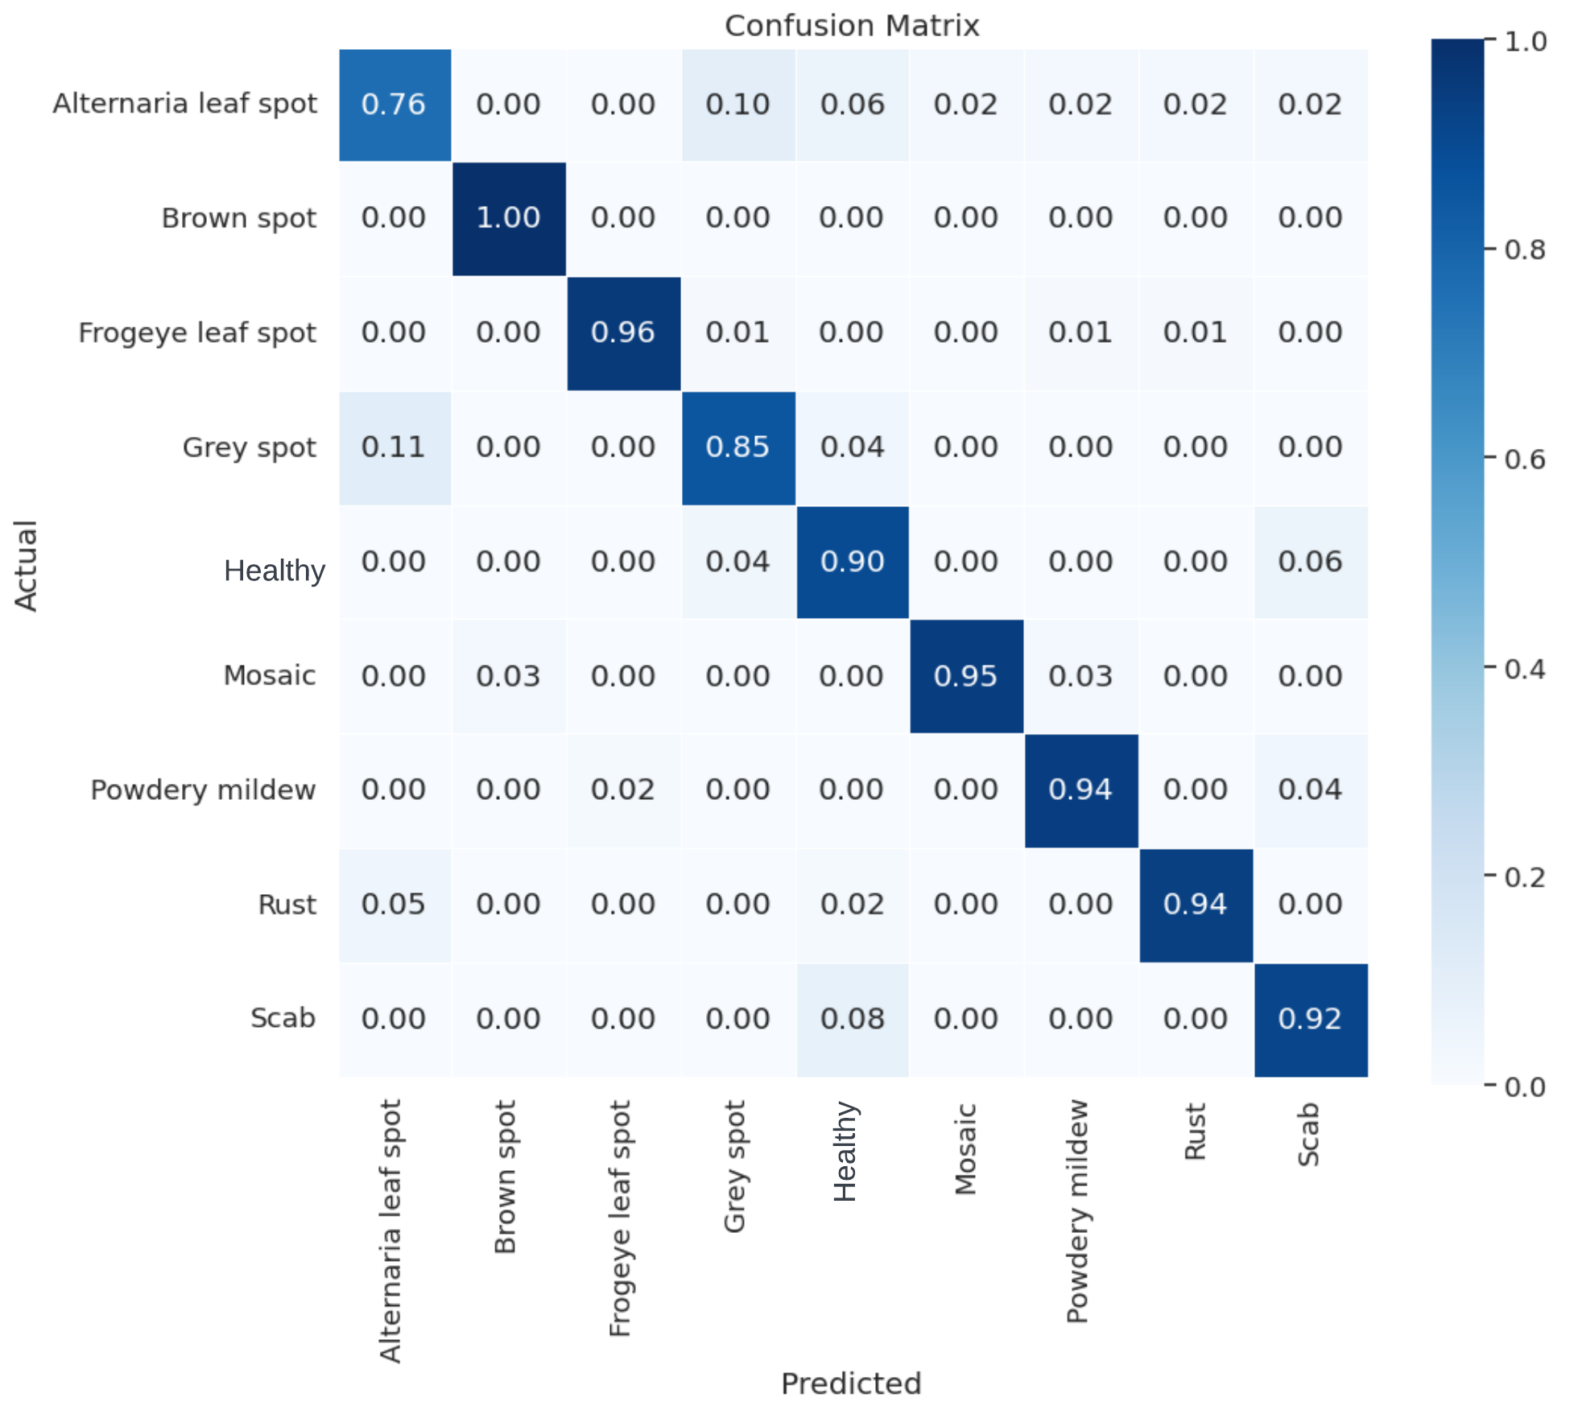
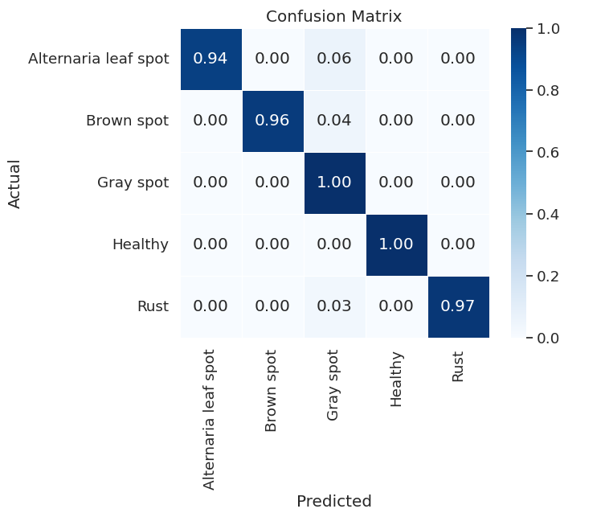
EXPERIMENTAL RESULT & DISCUSSION
Fig 5: Confusion matrix of our proposed model for the Reduced AppleLeaf9 dataset (Left) and the ATLDSD dataset (right).

Slide 15
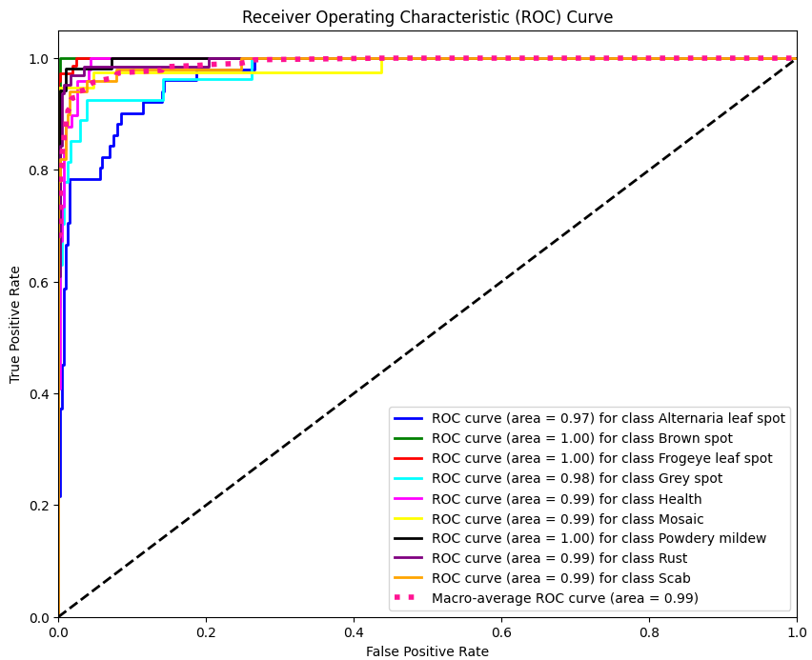
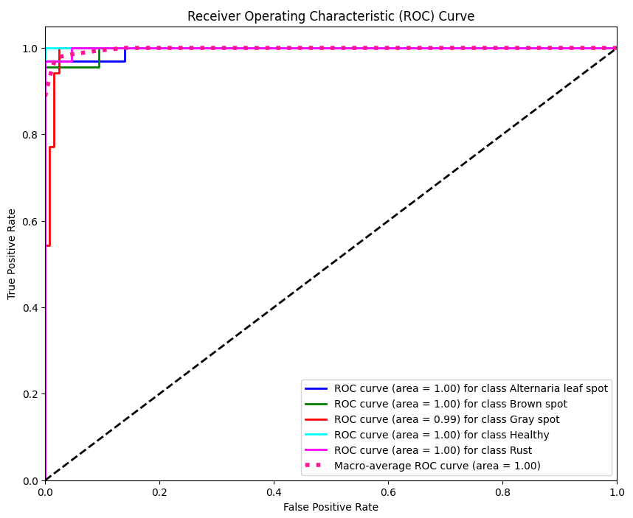
EXPERIMENTAL RESULT & DISCUSSION
Fig 6: Proposed model’s ROC curves with AUC scores for the Reduced AppleLeaf9 dataset (Left) and the ATLDSD dataset (right).

Slide 16
CONCLUSION AND FUTURE WORK
Through this study, a lightweight CNN model has been developed to recognize apple leaf diseases from real-time images.
The proposed model surpassed various deep CNN models across two datasets containing higher and lower numbers of classes.
In the future, our proposed model can be further enhanced to improve its performance.
It can be applied to diverse datasets containing a large number of images and categories to evaluate its performance on large datasets.

Slide 17
REFERENCES
[1] Fresh apple. https://www.tridge.com/intelligences/apple/production, 2024. Accessed: March 5, 2024.
[2] Asif Iqbal Khan, SMK Quadri, Saba Banday, and Junaid Latief Shah. Deep diagnosis: A real-time apple leaf disease detection system based on deep learning. computers and Electronics in Agriculture, 198:107093, 2022.
[3] Ayodeji B Oyenihi, Zinash A Belay, Asanda Mditshwa, and Oluwafemi J Caleb. “an apple a day keeps the doctor away”: The potentials of apple bioactive constituents for chronic disease prevention. Journal of food science, 87(6):2291–2309, 2022.
[4] Anupam Bonkra, Pramod Kumar Bhatt, Joanna Rosak-Szyrocka, Kamalakanta Muduli, Ladislav Pilaˇr, Amandeep Kaur, Nidhi Chahal, and Arun Kumar Rana. Apple leave disease detection using collaborative ml/dl and artificial intelligence methods: scientometric analysis. International journal of environmental research and public health, 20(4):3222,2023.
[5] Helong Yu, Xianhe Cheng, Chengcheng Chen, Ali Asghar Heidari, Jiawen Liu, Zhennao Cai, and Huiling Chen. Apple leaf disease recognition method with improved residual network. Multimedia Tools and Applications, 81(6):7759–7782, 2022.
[6] Melike Sardogan, Yunus ̆ Ozen, and Adem Tuncer. Detection of apple ̈leaf diseases using faster r-cnn. Duzce ̈ Universitesi Bilim ve Teknoloji ̈ Dergisi, 8(1):1110–1117, 2020.
[7] Peng Jiang, Yuehan Chen, Bin Liu, Dongjian He, and Chunquan Liang. Real-time detection of apple leaf diseases using deep learning approach based on improved convolutional neural networks. IEEE Access, 7:59069–59080, 2019.

Slide 18
REFERENCES
[8] Nahida Bashir, Himanshu Sharma, Devanand Padha, and Arvind Selwal. Exploring data-driven approaches for apple disease prediction systems. In Proceedings of International Conference on Recent Innovations in Computing: ICRIC 2022, Volume 1, pages 117–125. Springer, 2023.
[9] Vibhor Kumar Vishnoi, Krishan Kumar, Brajesh Kumar, Shashank Mohan, and Arfat Ahmad Khan. Detection of apple plant diseases using leaf images through convolutional neural network. IEEE Access, 11:6594–6609, 2022.
[10] Lili Fu, Shijun Li, Yu Sun, Ye Mu, Tianli Hu, and He Gong. Lightweight-convolutional neural network for apple leaf disease identification. Frontiers in Plant Science, 13:831219, 2022.
[11] Cevher Ozden. Apple leaf disease detection and classification based ̈on transfer learning. Turkish Journal of Agriculture and Forestry, 45(6):775–783, 2021.
[12] Xin Li and Laxmisha Rai. Apple leaf disease identification and classification using resnet models. In 2020 IEEE 3rd International Conference on Electronic Information and Communication Technology (ICEICT), pages 738–742. IEEE, 2020.
[13] VV Srinidhi, Apoorva Sahay, and K Deeba. Plant pathology disease detection in apple leaves using deep convolutional neural networks: Apple leaves disease detection using efficientnet and densenet. In 2021 5th international conference on computing methodologies and communication (ICCMC), pages 1119–1127. IEEE, 2021.
[14] Poornima Singh Thakur, Tanuja Sheorey, and Aparajita Ojha. Vgg-icnn: A lightweight cnn model for crop disease identification. Multimedia Tools and Applications, 82(1):497–520, 2023.

Slide 19
REFERENCES
[15] Chongke Bi, Jiamin Wang, Yulin Duan, Baofeng Fu, Jia-Rong Kang, and Yun Shi. Mobilenet based apple leaf diseases identification. Mobile Networks and Applications, pages 1–9, 2022.
[16] Asif Iqbal Khan, SMK Quadri, and Saba Banday. Deep learning for apple diseases: classification and identification. International Journal of Computational Intelligence Studies, 10(1):1–12, 2021.
[17] Appleleaf9. https://github.com/JasonYangCode/AppleLeaf9, 2024. Accessed: May 15, 2024.
[18] Qing Yang, Shukai Duan, and Lidan Wang. Efficient identification of apple leaf diseases in the wild using convolutional neural networks. Agronomy, 12(11):2784, 2022.
[19] JFJ Feng and XCX Chao. Apple tree leaf disease segmentation dataset. Science Data Bank: Beijing, China, 2022.

Slide 20
Thank You
Any Questions?

